Slide 1
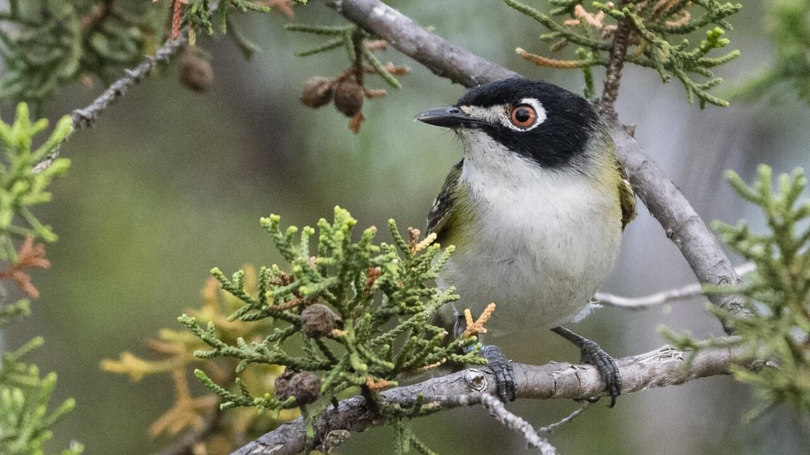
Improving Habitat suitability models for endangered species using remotely sensed data
LiDAR Mini Project
Zack Loken

Slide 2
Motivation for Study
Identifying suitable habitats is critical to endangered species management
Veg structure & composition are strong determinants of habitat suitability for birds
Black-capped vireo—an endangered bird with a small breeding range in central TX.
LiDAR is becoming readily available—curious if LiDAR-derived measures of vegetation structure can improve habitat suitability models for the black-capped vireo in Fort Hood.

Slide 3
What did the study do?
Identified potential vireo habitat in Fort Hood using aerial imagery
Surveyed these areas on foot—GPS locations of males recorded
Constructed DEM using LiDAR point cloud
Generated four LiDAR-derived variables for measuring vireo habitat
Mean height woody veg
Percent cover woody veg (1 – 30m tall)
Percent cover woody veg (1 – 3 m tall)
Total edge length
Manually delineated veg patches using 0.35m resolution orthophotos

Slide 4
What did the study do? Continued
Pulled soil data from the NRCS soils database
Converted LiDAR, veg, and soil layers to raster grids at six spatial resolutions (10 – 500m)
Constructed habitat suitability models (HSM) using the Random Forest algorithm
Identified best-performing resolution for each data class, then constructed final models
Structure + Composition: 81% accuracy
Structure + Soil Depth: 80% accuracy
Composition + Soil Depth: 80% accuracy
Structure + Composition + Soil Depth: 82% accuracy
Calculated variable importance in addition to model accuracy

Slide 5
What did they learn?
Remotely sensed data products can be used effectively to scale up HSM predictions
The 25-m resolution HSM performed best
Finer resolution may not capture grass and shrub patchiness associated with vireos
Aggregation to coarser resolutions likely introduces errors in the model
Results suggest that in central TX, the veg composition is a more important predictor of vireo occupancy than structural (i.e., LiDAR-derived) attributes
A map based on vegetation composition is more suitable for conservation action because it identifies areas of current and potential habitat

Slide 6
How’s it differ from classwork?
This study only looked at LiDAR data from one time, whereas most of what we’ve done in class deals with change detection before and after some event.
Furthermore, we’ve mostly focused on ground position change, whereas this study used LiDAR to derive metrics of vegetation structure (disregarding ground returns)

Slide 7
What did I do?
Background: Jack Mountain fire burned 11,380 acres across Fort Hood combined (2011)
Their study concluded that a map of vegetation composition is more suitable for conservation action, but mapping vegetation is time-consuming and dataset quality is iffy.
Hypothesis: Before and after 2D canopy height models can be differenced to quickly assess spatially explicit impacts of natural disasters on vegetation communities, which can be used to make inferences about where endangered species that require early-successional communities to survive (e.g., black-capped vireo).

Slide 8
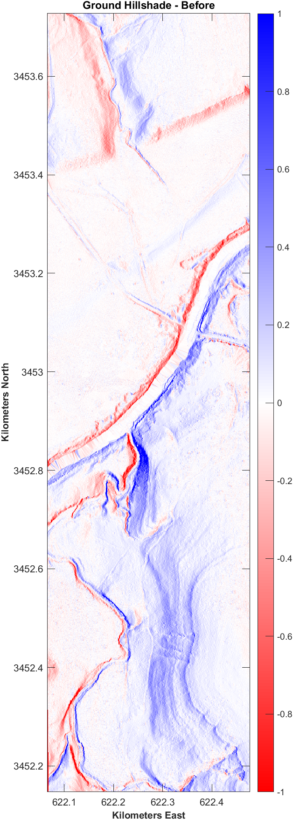
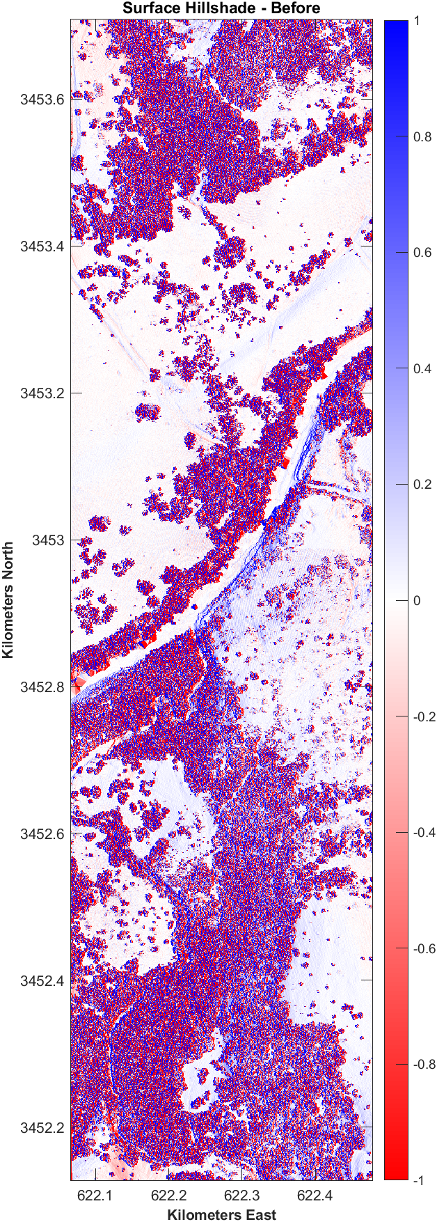
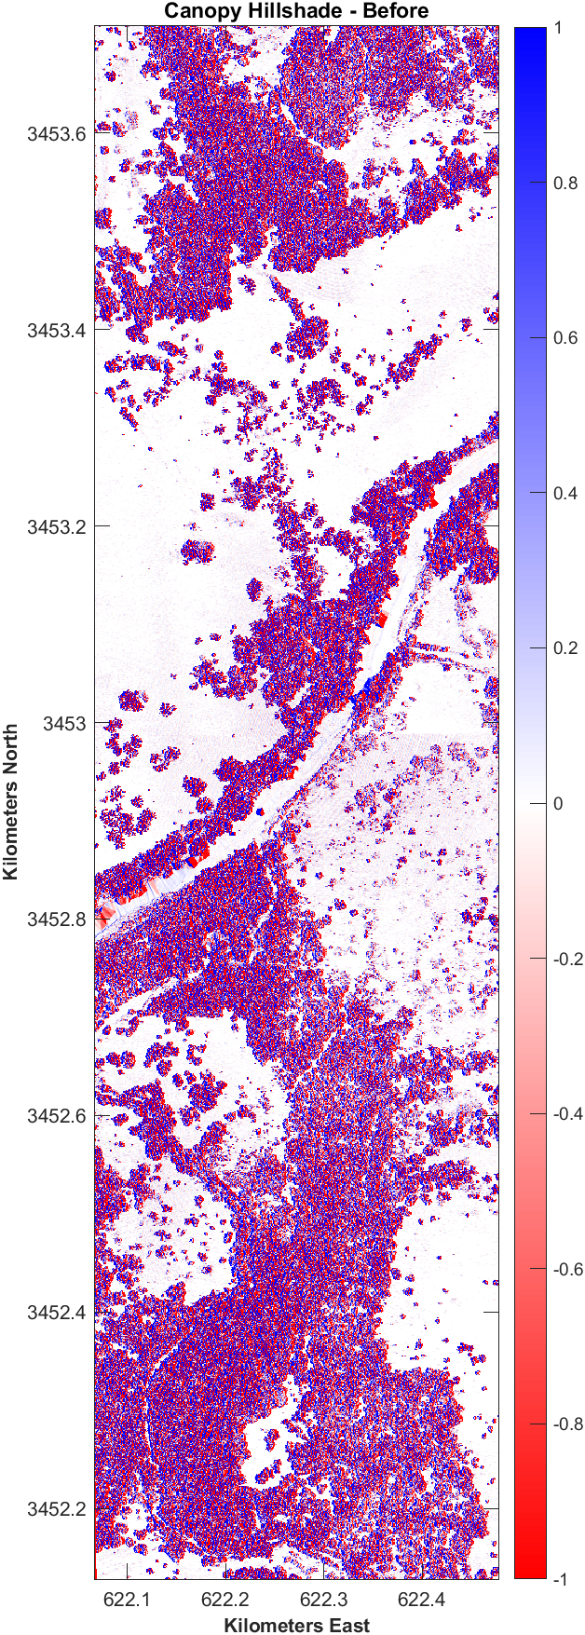
Fort Hood - 2011
Months before Jack Mtn fire
Data includes:
LiDAR-derived DEM
Ground returns
LiDAR-derived DSM
First returns
LiDAR-derived Canopy Height
DSM – DEM (first – ground)

Slide 9
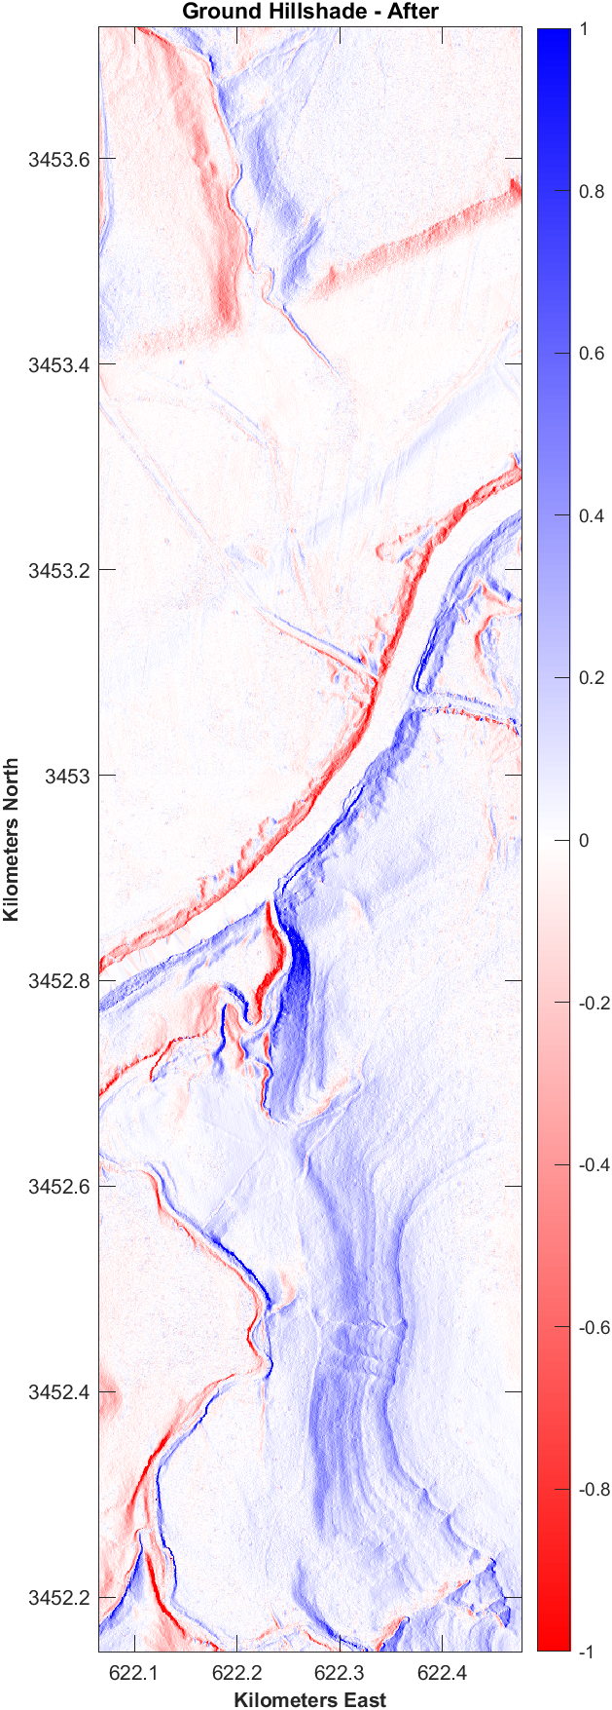
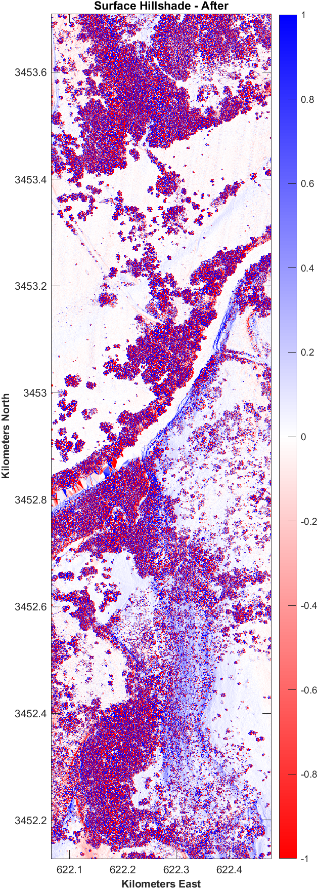
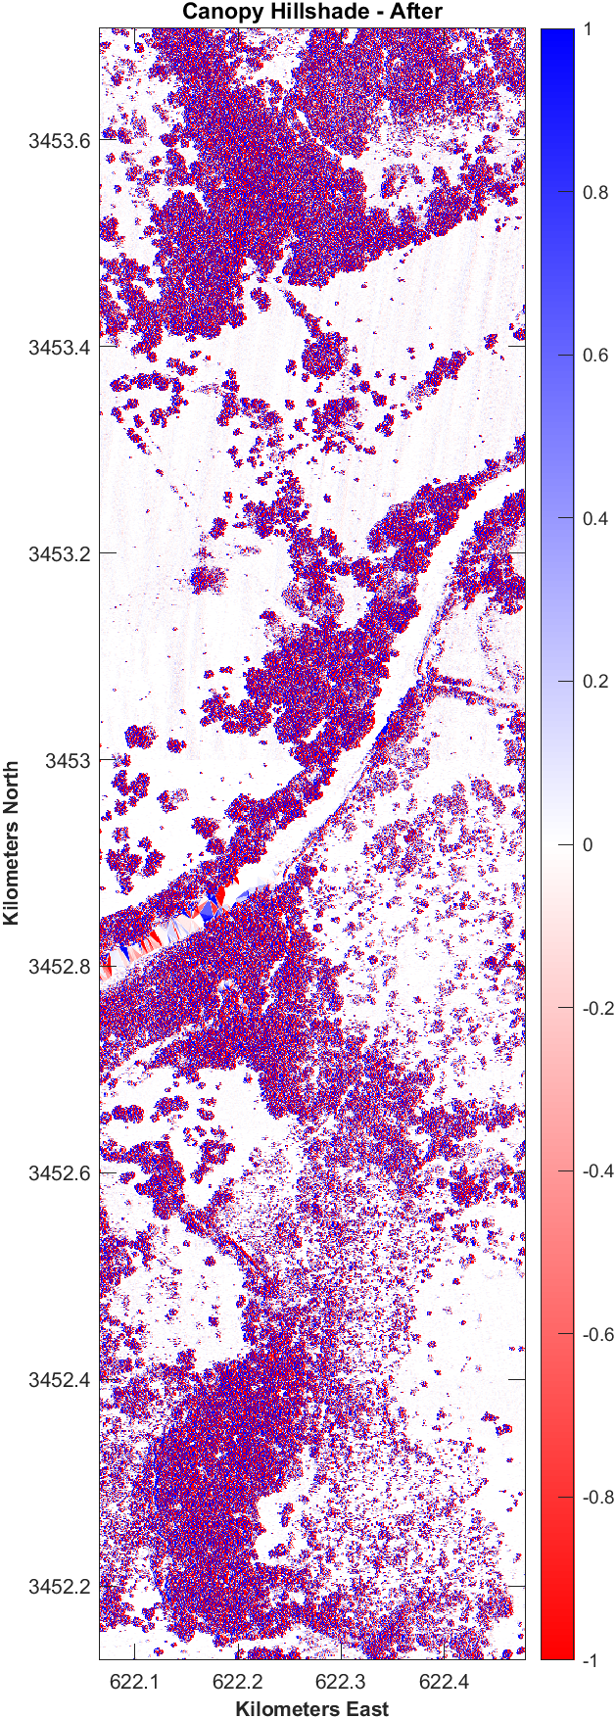
Fort Hood - 2017
Six years after Jack Mtn Fire
Same 3 LiDAR-derived datasets
DEM - After
DSM - After
CHM - After

Slide 10
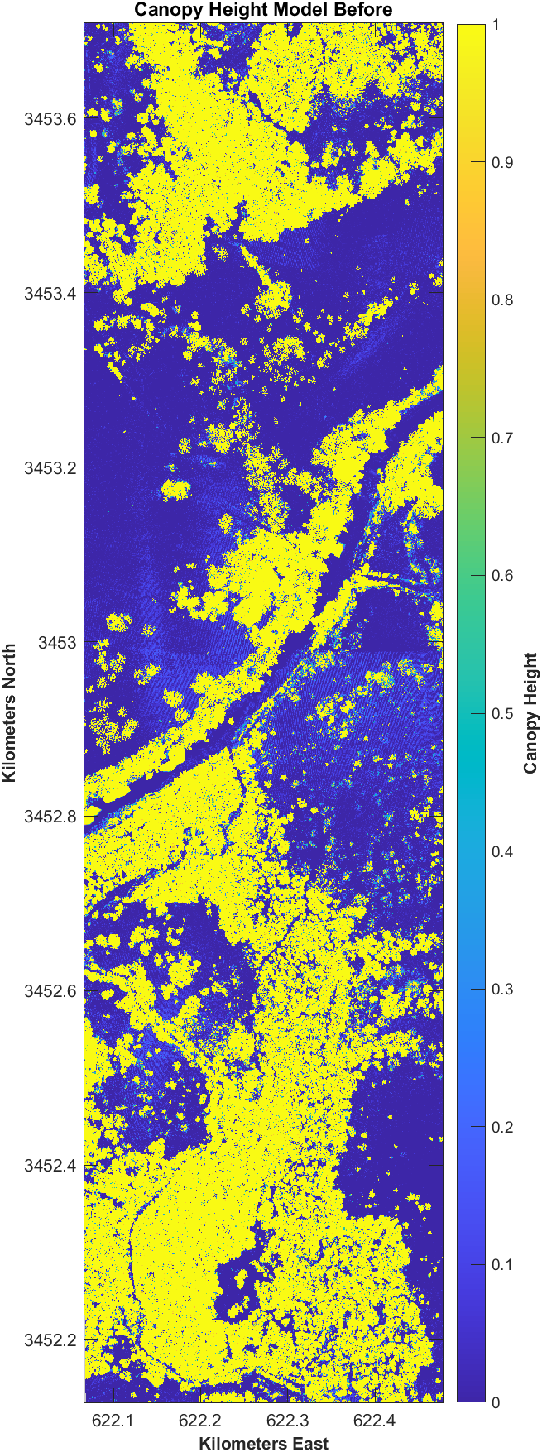
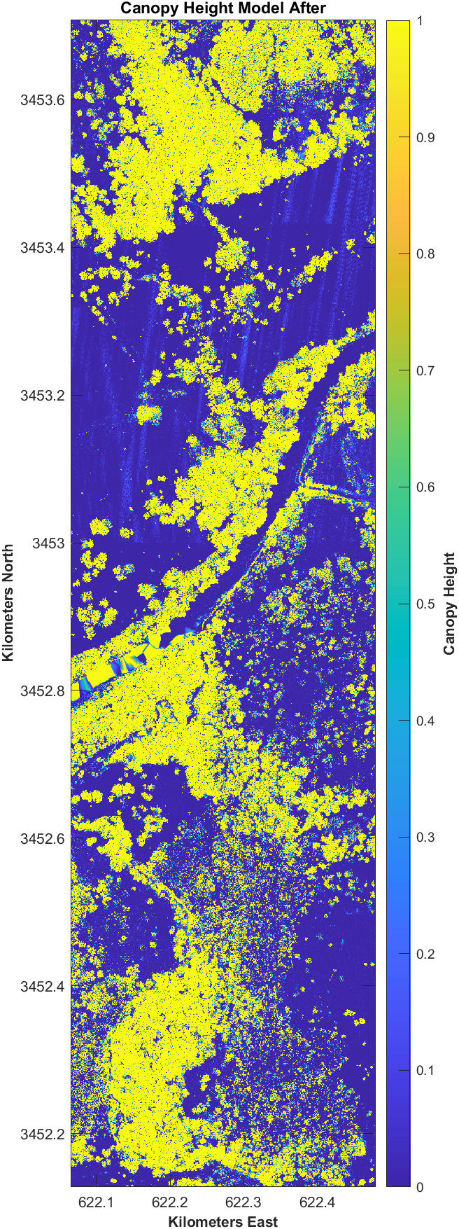
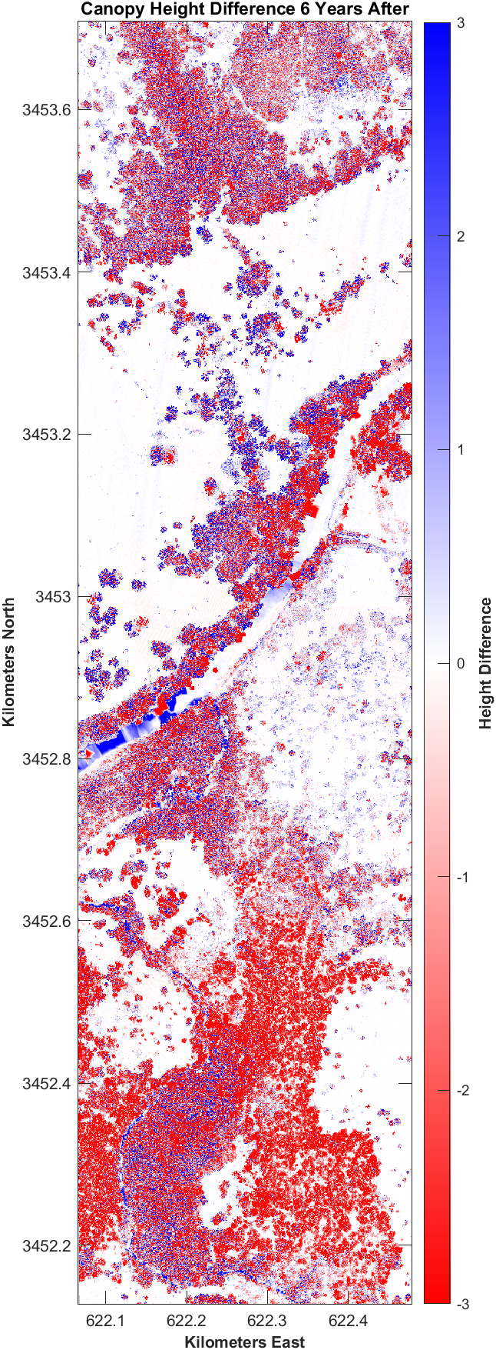
Canopy Height Difference
Canopy height model after minus canopy height model before
Shows overall canopy loss/gain
Significant canopy loss in the southern third of the study area
CHM Difference:
Dark blue—trees not burned; height increased
Dark red—trees burned; height decreased
Light blue—shrub growth after fire
Light red—shrubs lost during the fire

Slide 11
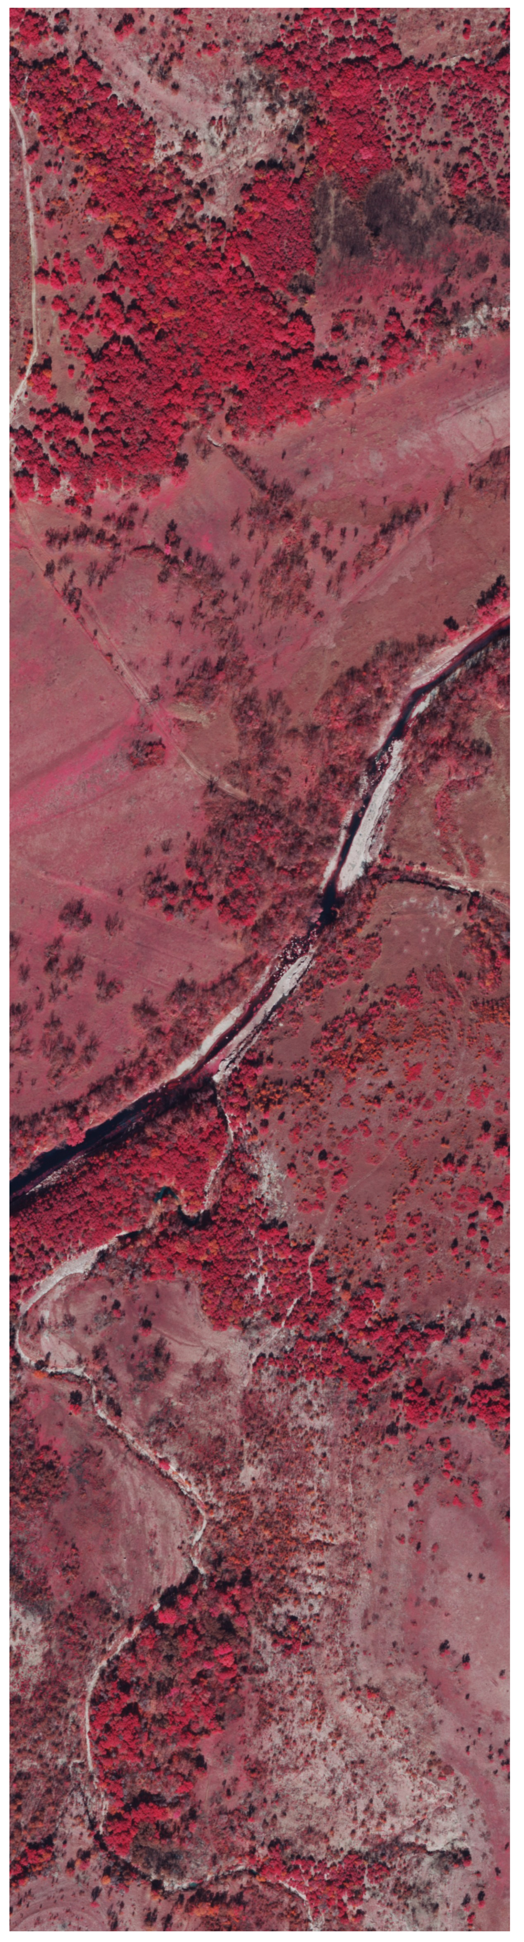
Conclusion
Habitat that could support vireo!
Habitat that could support vireo!
LiDAR-derived canopy height differencing using pre- and post-event data can:
Spatially quantify structural changes to veg communities
Provide additional details about veg community composition when coupled with aerial imagery
For example, aerial imagery can help visually separate plant communities (forest vs shrub vs tree) but fails to quantify important habitat metrics such as canopy height/density.
Coupling aerial imagery with canopy height difference layer is sufficient to identify potentially suitable habitats for species of interest; no need to go through all the steps they did in the paper for preliminary analyses.

Slide 12
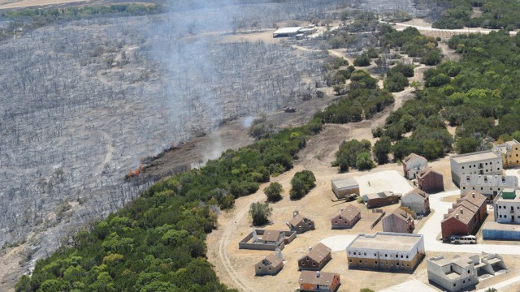
Study: Performance of habitat suitability models for the endangered black-capped vireo built with remotely sensed data. Wilsey et al., 2011.
Questions?

